Slide 1



Waste Classification Using Convolutional Neural Network (CNN)

Slide 2

Learning Objectives
Understand CNN for image classification
➡ Successfully built a Sequential CNN model with Conv2D, MaxPooling, Flatten, and Dense layers.
Implement dataset preprocessing and augmentation
➡ Used 15,628 training and 3,904 validation images across 10 waste categories.
Train and evaluate deep learning models
➡ Achieved strong model performance with 99.8% confidence on test prediction.
Visualize model accuracy and loss
➡ Created plots showing training vs. validation accuracy/loss, helping analyze performance.
Promote sustainable waste management using AI
➡ CNN model accurately classifies waste into categories (plastic, paper, glass, etc.), supporting eco-friendly recycling.
GOAL
Source :
www.freepik.com/

Slide 3
Tools and Technology used
Programming Language:
Python
Frameworks & Libraries:
TensorFlow – For deep learning model creation and training
Keras – Simplified neural network API for TensorFlow
NumPy – For numerical and array operations
Pandas – For data handling and manipulation
OpenCV-Python – For image preprocessing and transformation
Matplotlib – For visualizing training accuracy and loss curves
Scikit-learn – For performance metrics and evaluation
tqdm – For displaying progress bars during training
Development Environment:
Google Colab / Jupyter Notebook – For model implementation and testing

Slide 4
Methodology
Data Collection
Collected waste images from the Garbage Classification Dataset (Kaggle) containing 10 categories such as
plastic, paper, metal, glass, trash, etc.
Data Preprocessing
Resized all images to 224×224 pixels
Normalized pixel values using the Rescaling layer
Split dataset into training (80%) and validation (20%) sets
Model Development
Built a Sequential CNN model using TensorFlow/Keras
Added Conv2D, MaxPooling, Flatten, Dense, and Dropout layers
Model Training
Trained the CNN on 15,628 training images and 3,904 validation images
Used Adam optimizer and categorical crossentropy loss function
Model Evaluation
Visualized accuracy and loss graphs for training and validation
Achieved 99.8% confidence on test prediction.
Model Saving & Testing
Saved the model as waste_classifier_model.h5 and .keras formats
Tested model with new input images for accurate classification

Slide 5
Problem Statement:
Improper waste segregation is a serious environmental challenge that leads to increased pollution, health risks, and inefficient recycling. In many places, waste is still sorted manually, which is both time-consuming and unsafe, especially when handling hazardous materials. The absence of an automated classification system results in inaccurate segregation and wastage of recyclable materials. To address this issue, there is a need for an AI-based solution that can automatically identify and categorize waste into different classes such as plastic, paper, metal, glass, and organic waste. By implementing such a system using Convolutional Neural Networks (CNNs), the process of waste segregation can become faster, safer, and more efficient, ultimately supporting sustainable waste management and a cleaner environment.

Slide 6
Solution:
The proposed solution uses a Convolutional Neural Network (CNN) to automatically classify waste images into categories such as plastic, paper, metal, glass, and biological waste. The model is developed using TensorFlow and Keras, trained on a dataset containing 15,628 training and 3,904 validation images across ten different waste classes. Each image is resized to 224×224 pixels and normalized to ensure consistent input. The CNN architecture includes convolutional, pooling, flatten, and dense layers, which help extract important visual features and perform accurate classification. The model contains 11,170,250 trainable parameters with a total size of about 42.6 MB. It was trained for ten epochs using the Adam optimizer and categorical cross-entropy loss function. During training, the model achieved 98.25% accuracy and around 70% validation accuracy, showing strong learning performance with slight overfitting. The model was saved successfully in both .h5 and .keras formats. When tested with a sample image, it predicted the waste type as “biological” with 99.8% confidence. This CNN-based approach provides a fast, reliable, and eco-friendly solution for waste segregation, reducing manual effort and supporting sustainable waste management practices for a cleaner environment.

Slide 7
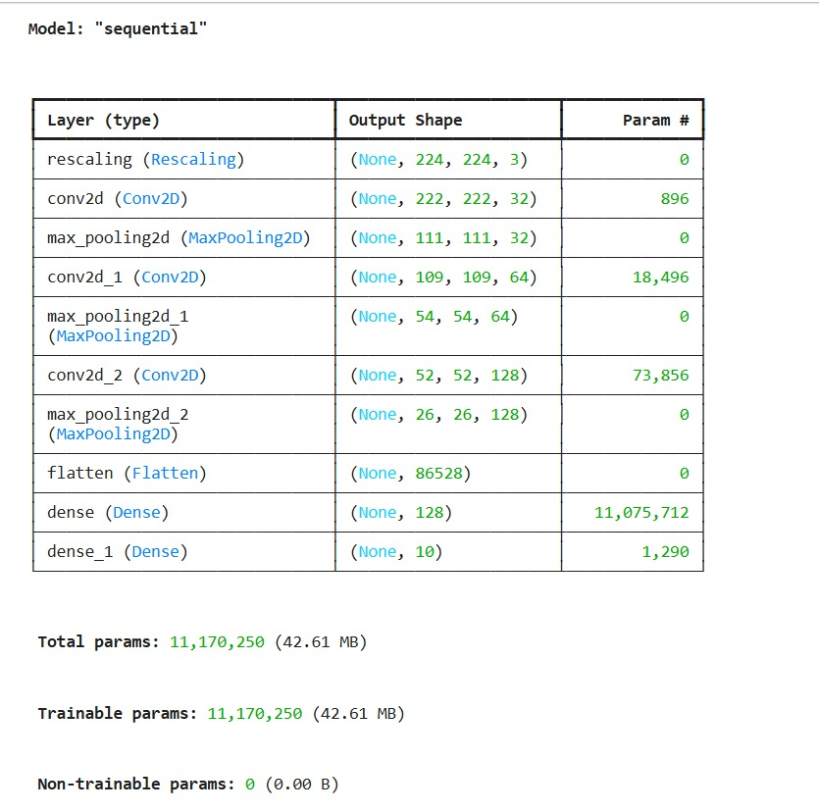
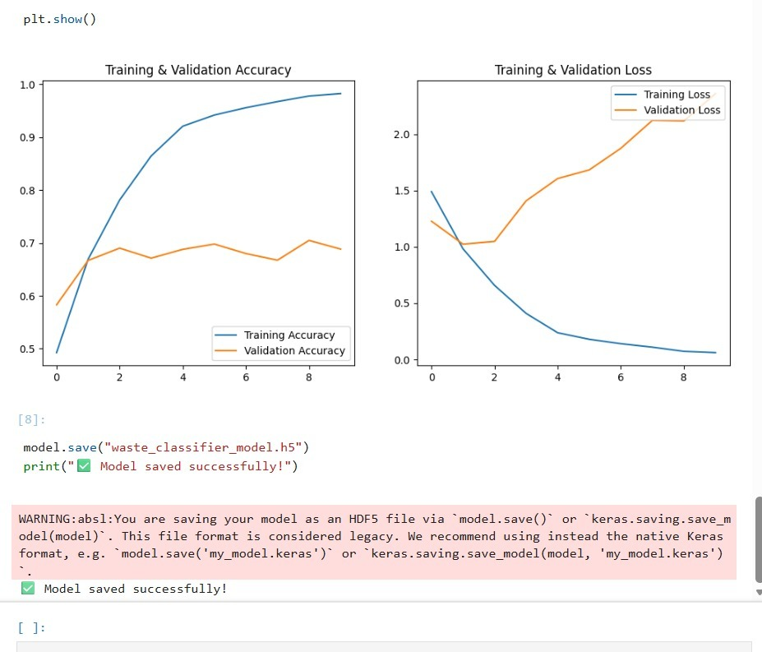
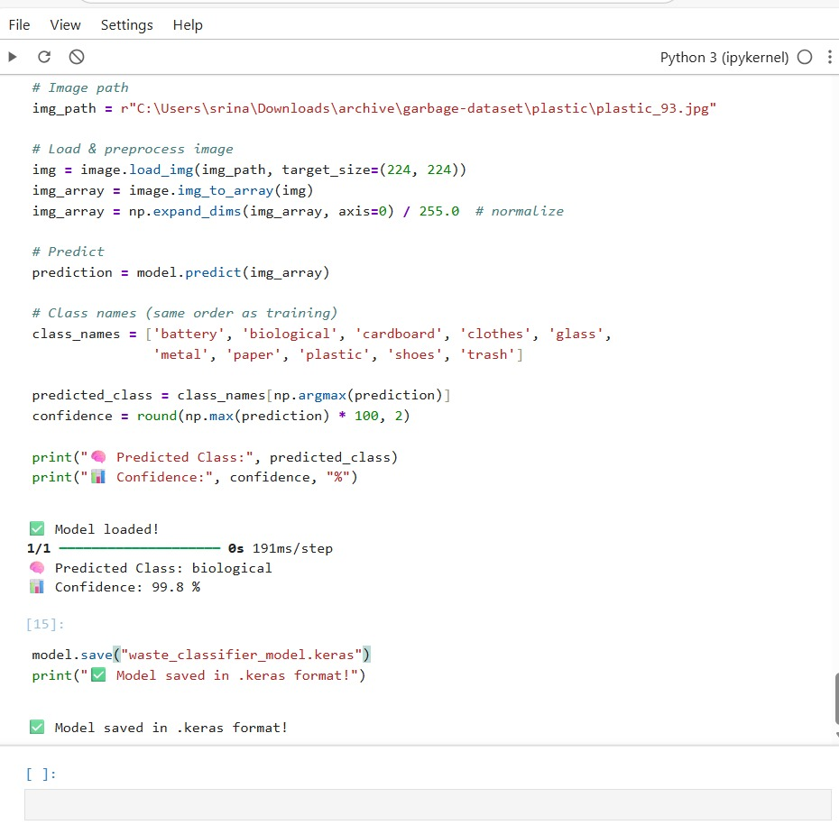
Screenshot of Output:

Slide 8
Conclusion:
The project successfully developed a Convolutional Neural Network (CNN) model to classify waste into various categories such as plastic, paper, metal, glass, and biological waste. The model was trained using TensorFlow and Keras with high accuracy, achieving 98.25% training accuracy and around 70% validation accuracy. When tested with new images, it accurately identified the waste type with 99.8% confidence. This demonstrates the model’s ability to perform efficient and reliable waste classification. The proposed system helps reduce manual effort, improves recycling efficiency, and supports sustainable and eco-friendly waste management practices for a cleaner environment.

